Slide 1


Convolutional Neural Networks mlhep 2019

Slide 2
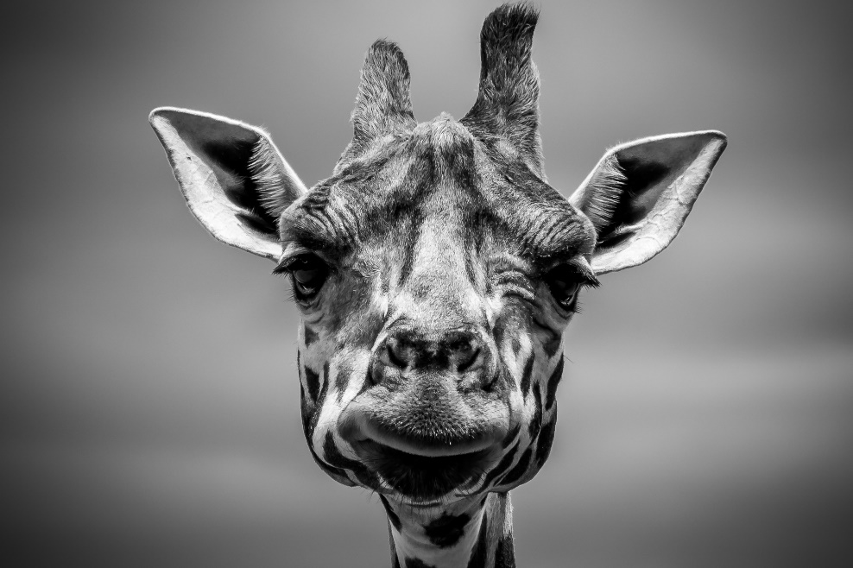

Images
Grayscale image is a matrix of pixels [H x W]
Pixels = picture elements
Each pixel stores number [0,255] for brightness
0
255
Slide from Andrey Zimovnov's “Deep learning for computer vision”

Slide 3
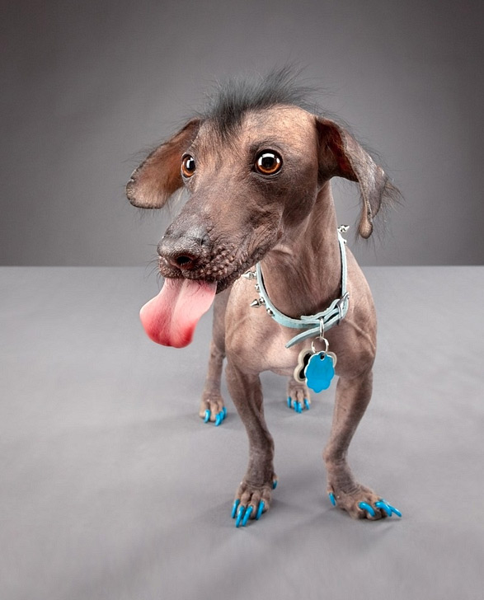
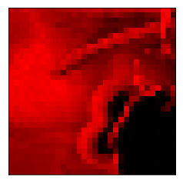
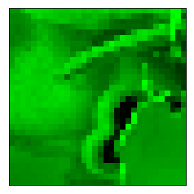
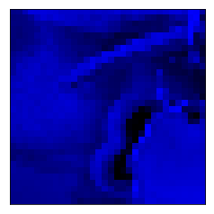
Images
RGB image is a 3d array [HxWx3] or [3xHxW]
Each pixel stores Red, Green & Blue color values [0,255]
Slide from Andrey Zimovnov's “Deep learning for computer vision”

Slide 4
Image recognition
“Dog”

Slide 5
Image recognition
“Gray wall”
“Dog tongue”
“Dog”
<a particular kind of dog>
“Animal sadism”

Slide 6
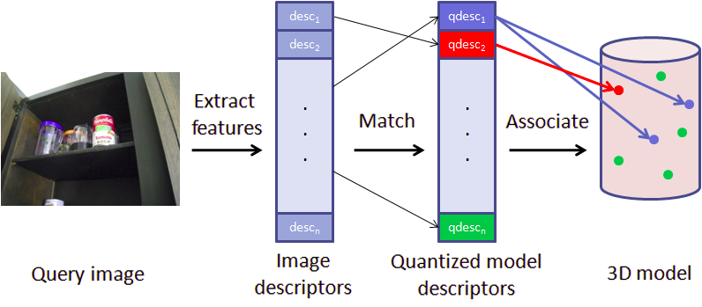
Classical approach
“Dog”
Guess what we're going to do now?

Slide 7

NN approach
P(Dog)

Slide 8
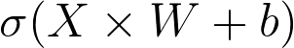
Problem with images
Weights
𝑤
ij
Slide from Andrey Zimovnov's “Deep learning for computer vision”

Slide 9

Problem with images
Weights
𝑤
ij
On this object, you will train red weights to react on cat face
Slide from Andrey Zimovnov's “Deep learning for computer vision”

Slide 10
Problem with images
Weights
𝑤
ij
On this object, you will train green weights to react on cat face
Slide from Andrey Zimovnov's “Deep learning for computer vision”

Slide 11
Problem with images
You network will have to learn those two cases separately!
Worst case: one neuron per position.
Slide from Andrey Zimovnov's “Deep learning for computer vision”

Slide 12
Problem
Idea: force all these “cat face” features to use exactly the same weights, shifting weight matrix each time.

Slide 13
Same features for each spot
Portable cat detector pro!
Weights
𝑤
ij
No cat

Slide 14
Same features for each spot
Portable cat detector pro!
Weights
𝑤
ij
No cat
No cat

Slide 15
Same features for each spot
Portable cat detector pro!
Weights
𝑤
ij
No cat
No cat
Cat!

Slide 16
Same features for each spot
Portable cat detector pro!
Weights
𝑤
ij
No cat
No cat
Cat!
No cat

Slide 17
Same features for each spot
Portable cat detector pro!
Weights
𝑤
ij
No cat
No cat
There's a cat here!
Cat!
No cat

Slide 18
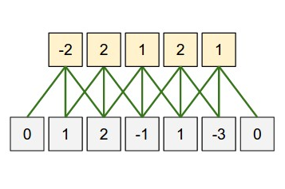
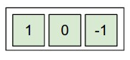
Convolution
Apply same weights to all patches
output
weights
image

Slide 19
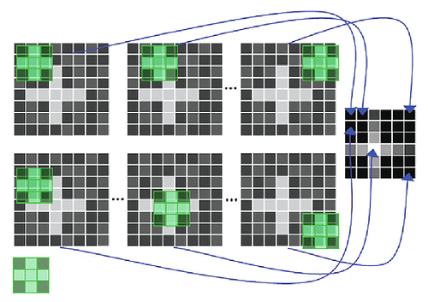
Convolution
apply one “filter” to all patches

Slide 20

Convolution
5x5
3x3 (5-3+1)
Intuition: how cat-like is this square?

Slide 21
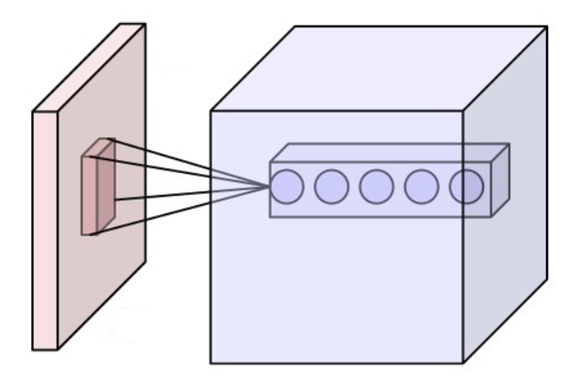
Convolution
Intuition: how cat-like is this square?

Slide 22
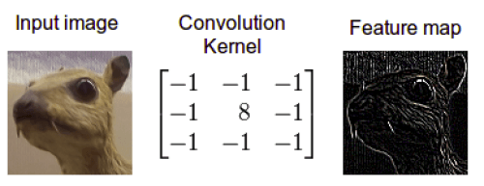
Convolution
Intuition: how edge-like is this square?

Slide 23
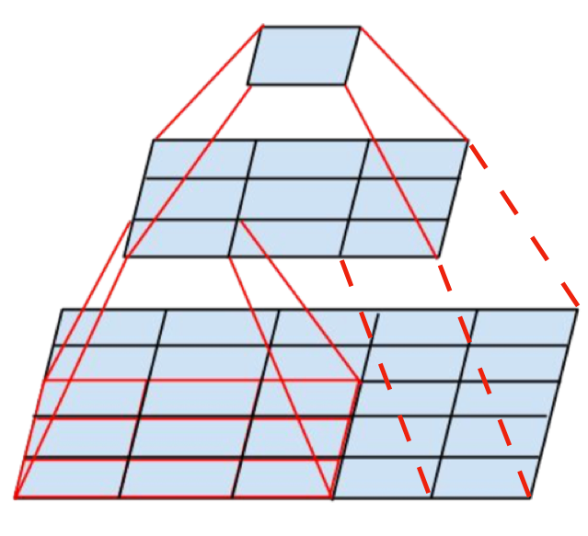
Receptive field
First 3x3 conv
receptive field 5x5
Second 3x3 conv
receptive field 3x3
We can recognize larger objects by stacking several small convolutions!

Slide 24
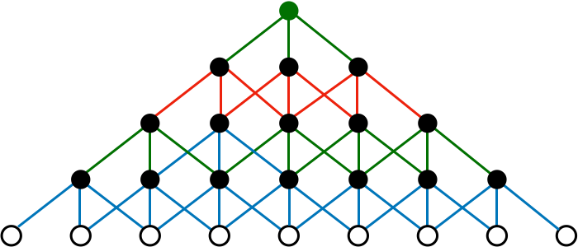
Receptive field
4
th
1x9
3
rd
1x7
2
nd
1x5
1
st
1x3
conv
layer
1x3
inputs
Q: how many 3x3 convolutions we should use to recognize a 100x100px cat

Slide 25
Receptive field
4
th
1x9
3
rd
1x7
2
nd
1x5
1
st
1x3
conv
layer
1x3
inputs
Q: how many 3x3 convolutions we should use to recognize a 100x100px cat
A: around 50... we need to increase receptive field faster!

Slide 26

Pooling
Intuition: What is the highest catness over this area?

Slide 27
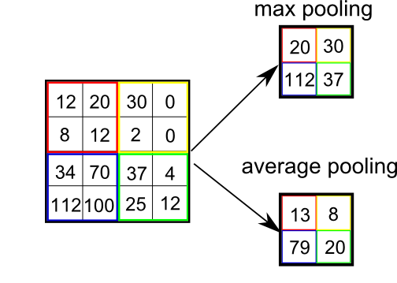
Pooling
Motivation:
Reduce layer size by a factor
Make NN less sensitive to small image shifts
Popular types:
Max
Mean(average)

Slide 28
Convolution
?!
Filters: 100x(3x5x5)
Image : 3 (RGB) x 100 px x 100 px

Slide 29
Convolution
100x96x96
~10^6
Filters: 100x(3x5x5)
Image : 3 (RGB) x 100 px x 100 px
Somewhat too many!

Slide 30
Convolution
100x96x96
~10^6
Filters: 100x(3x5x5)
Image : 3 (RGB) x 100 px x 100 px
100x96x96
pool
3x4
???

Slide 31
Convolution
100x96x96
~10^6
Filters: 100x(3x5x5)
Image : 3 (RGB) x 100 px x 100 px
100x96x96
pool
3x4
100x32x32
~10^5

Slide 32
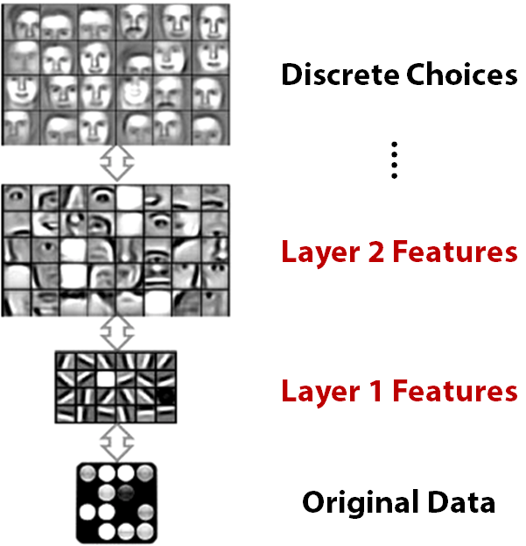

Slide 33
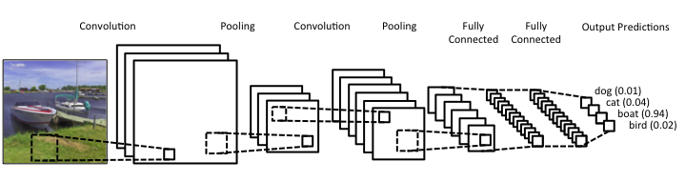
Convolutional NNs

Slide 34
Convolutional NNs
32 filters 5x5
3x3
3x3
64 filters 5x5
512
512
4
3x100x100
Quiz:
1) What is the output shape after second pooling

Slide 35
Convolutional NNs
32 filters 5x5
3x3
3x3
64 filters 5x5
512
512
4
3x100x100
Quiz:
2) How many image pixels does one cell after second convolution depend on?

Slide 36
Convolutional NNs
32 filters 5x5
3x3
3x3
64 filters 5x5
512
512
4
3x100x100
Quiz:
3) Which layer is hardest to compute?
4) Which layer has most independent parameters?

Slide 37
Convolutional NNs
32 filters 5x5
3x3
3x3
64 filters 5x5
512
512
4
3x100x100
Quiz:
3) Which layer is hardest to compute?: first conv
4) Which layer has most independent parameters?
first dense

Slide 38
Problem with large networks
What you sign for if you stack 1000 layers:
MemoryError(0x...)
Gradients can vanish
Gradients can explode
Activations can vanish
Activations can explode

Slide 39
Problem with large networks
What you sign for if you stack 1000 layers:
MemoryError(0x...)
Gradients can vanish
Gradients can explode
Activations can vanish
Activations can explode
How do we fix these?

Slide 40
Problem with large networks
What you sign for if you stack 1000 layers:
MemoryError(0x...)
Gradients can vanish
Gradients can explode
Activations can vanish
Activations can explode
Batch normalization
or similar

Slide 41
Problem with large networks
What you sign for if you stack 1000 layers:
MemoryError(0x...)
Gradients can vanish
Gradients can explode
Activations can vanish
Activations can explode
In a few days
Batch normalization
or similar

Slide 42
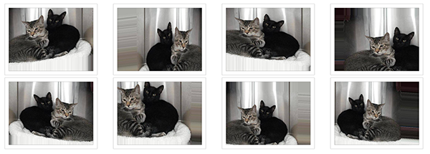
Data augmentation
Idea: we can get N times more data by tweaking images.
If you rotate cat image by 15°, it's still a cat
Rotate, crop, zoom, flip horizontally, add noise
Sound data: apply background noises

Slide 43
Other CV applications Real computer vision starts when image classification is no longer enough.

Slide 44
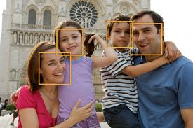
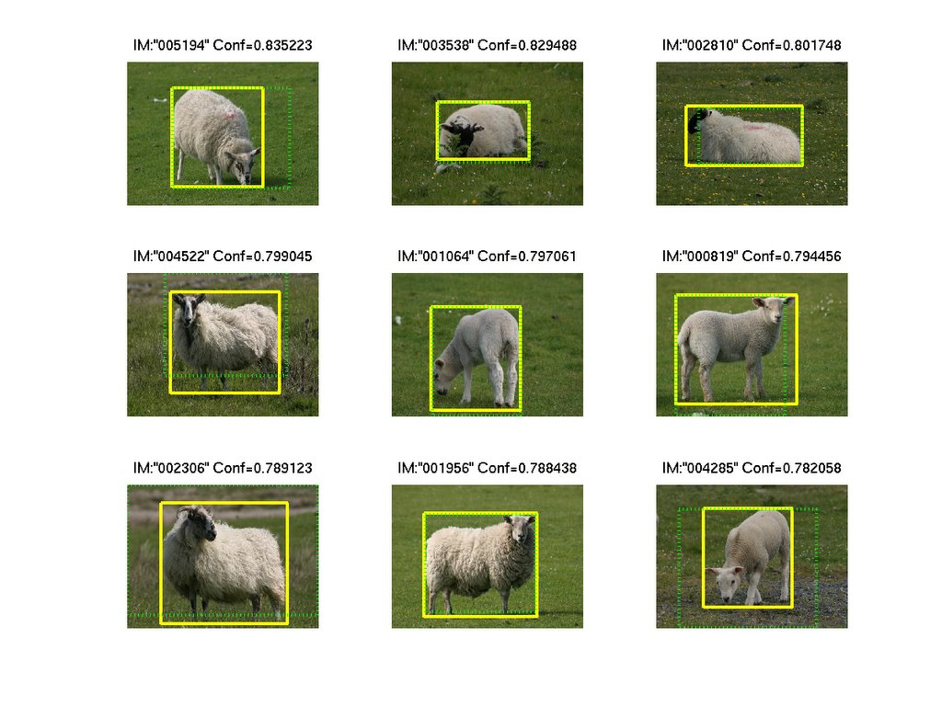
Bounding box regression
Predict object bounding box
(x0,y0,w,h)
or several bounding boxes for multiple objects.
Applications examples:
Face detection @ cameras
Surveillance cameras
Self-driving cars

Slide 45
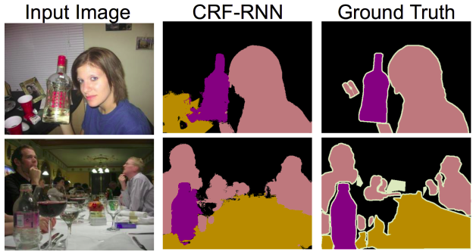
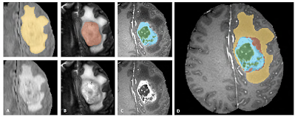
Segmentation
Predict class for each pixel
(fully-convolutional networks)
Applications examples:
Moar surveillance
Brain scan labeling
Map labeling

Slide 46
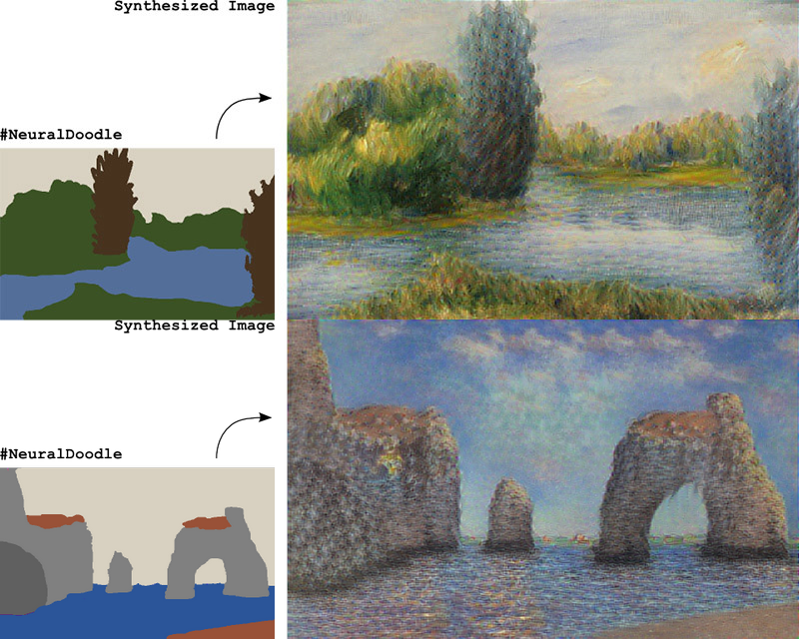
Image generation/transformation
Generation: Given a set of reference images, learn to generate new images, resembling those you were given.
Transformation: Given a set of reference images, learn to convert other images into ones resembling the reference set.
Neural Doodle
(D. Ulyanov et al.)

Slide 47
Fine-tuning Adversarial Networks Variational Autoencoders Knowledge transfer Domain adaptation Online learning Explaining predictions Soft targets Scene reconstruction 3D object retrieval Classifier optimization
Image tagging Image captioning Image retrieval Image encoding Image morphing
Image encoding
Image upscaling Object tracking on video
Video processing Video interpolation 3D point clouds

Slide 48
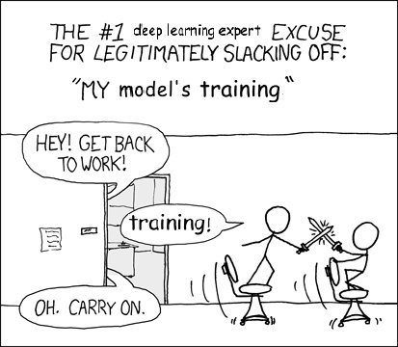
Nuff
Let's train some CNNs!

